Slide 1


Microsoft Teams Phone Training

Slide 2
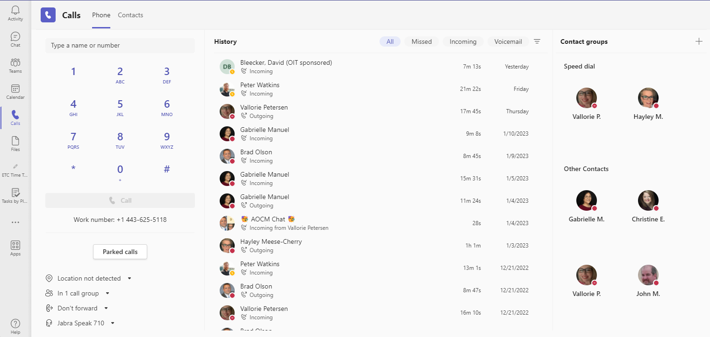
Desktop
The Calls landing page will display speed dial and suggested contacts. This will also include any speed dial groups you have created.
Use the menu in the upper-left corner to access contacts and the calls landing page.
eits.uga.edu

Slide 3
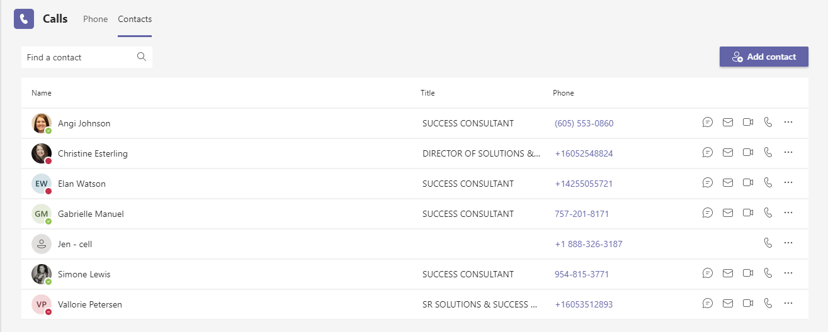
Contacts
Contacts are synced with contacts in Outlook or can also be added via Teams.
If enabled with external dialing, storing contacts makes it easy to initiate external calls with one click.
eits.uga.edu

Slide 4
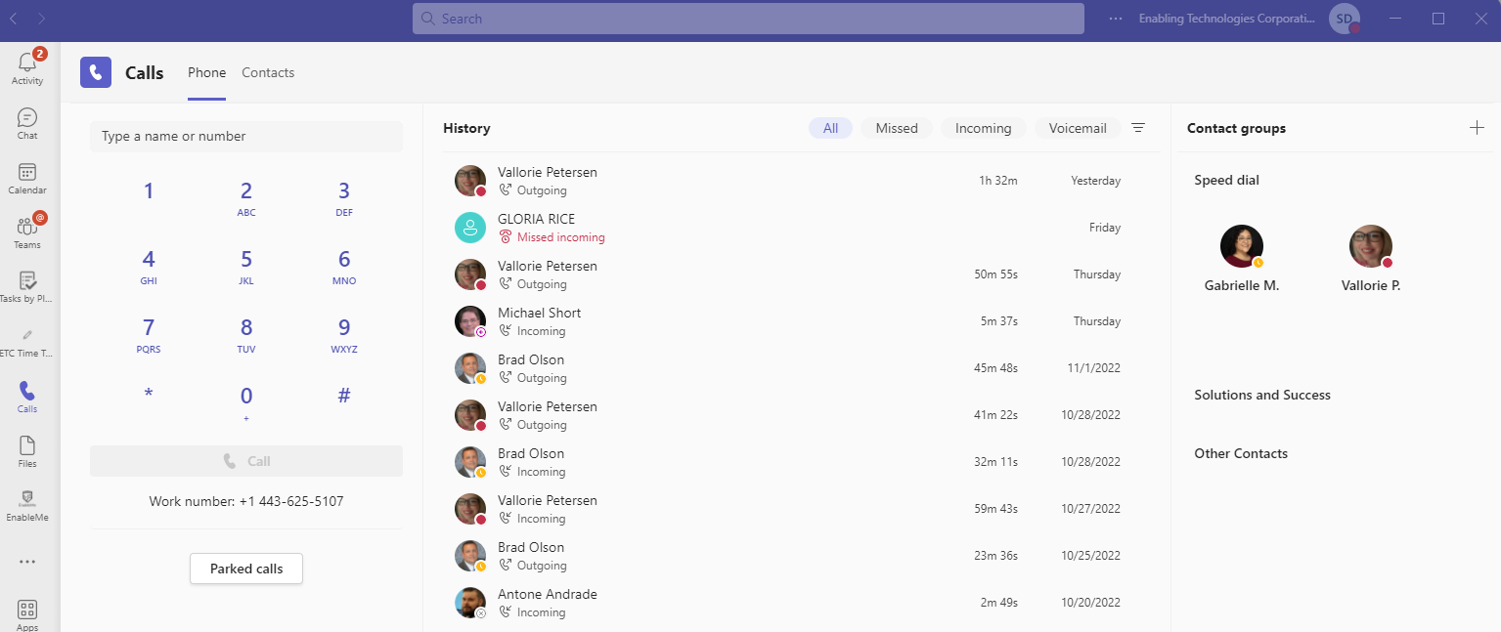
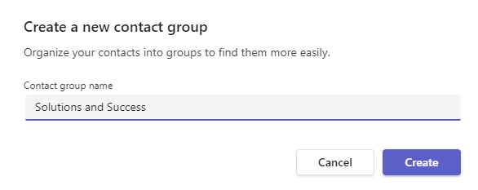
Creating Contact Groups
You can create a contact group by navigating to the top right corner in the Teams Calls landing page.
Click the plus icon to the right of Contact groups. Next enter the name of the group and start adding contacts.
You can also create a contact group in the Chat page. Next to Chat, click on the carat and select Contacts. From there, select Create a new contact group and follow the steps to create your custom contact group.
eits.uga.edu

Slide 5
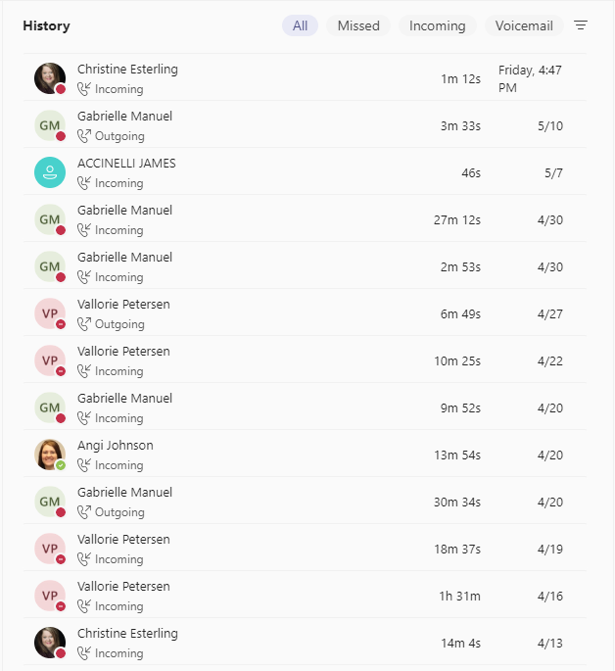
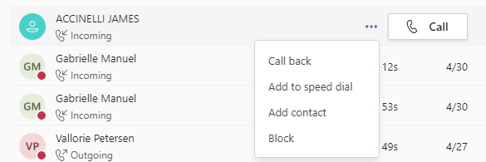
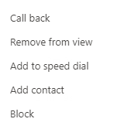
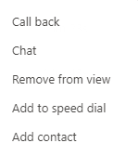
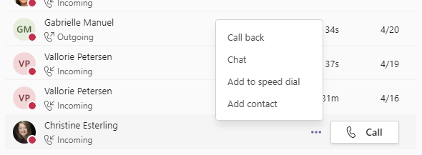
History
Call history will show you all calls received, initiated or missed in the last 30 days, at least.
Hover your mouse over the call entry line to make the Call button and the “…” More Options menu appear. More options include:
Call back
Remove from view
Chat (only available for internal callers)
Add to speed dial
Add contact
Block (only available for external callers)
eits.uga.edu

Slide 6
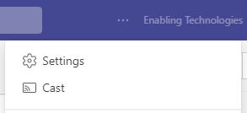
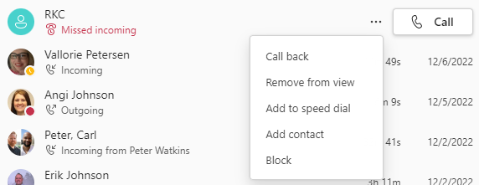
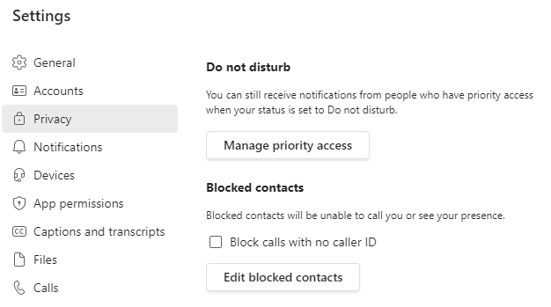
Blocking Unwanted Calls
Blocking Unwanted Calls
In your Call History click the ellipsis next to the unwanted call/number and select Block.
Managing Blocked/Unwanted Calls
Click Settings, then Privacy.
In privacy, click Edit Blocked Contacts.
The number will be added to your blocked list in Settings.
Note: You can only block External callers.
To unblock a call/number, simply click Unblock.
eits.uga.edu

Slide 7
Voicemail

Slide 8
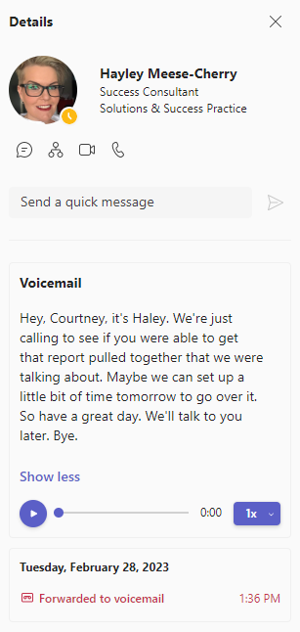

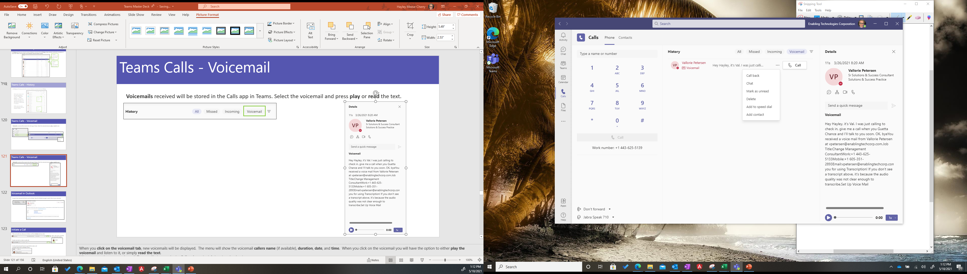
Voicemail
Voicemails received will be stored in the Calls app in Teams.
Select the voicemail menu in the History section and click a message to play the message and display additional information in the Details pane shown to the right.
From the More Options menu you can return the call, initiate a chat (if internal caller), manage the message, or add the caller to your contacts.
eits.uga.edu

Slide 9

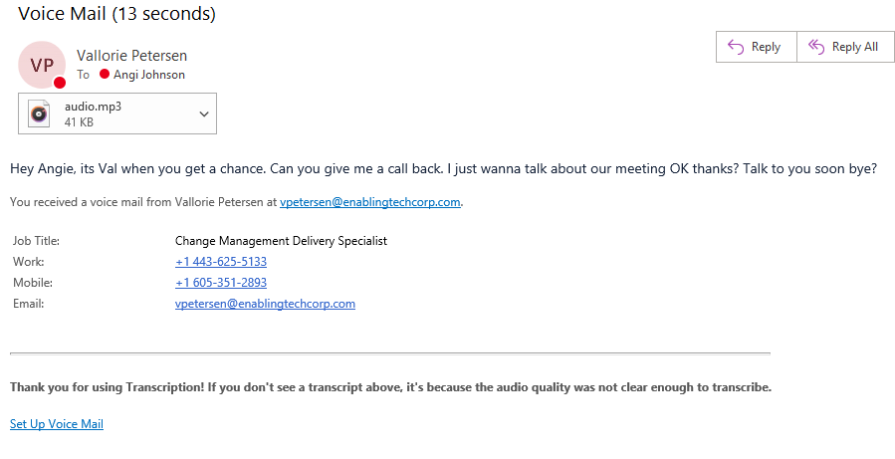
Voicemails in Outlook
A copy of each voicemail will also be sent to Outlook. Open the Outlook message to read or listen to your voicemails. Note: Deleting a voicemail message from Outlook will also delete it from your Calls app and vice versa.
eits.uga.edu

Slide 10
Calling

Slide 11
Emergency Calls
Because of the mobile nature of Teams Phone, we recommend that you do not call 911 from the Teams app.
Please dial from your native cellphone dialer for best response times.
eits.uga.edu

Slide 12
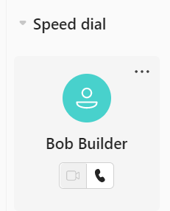
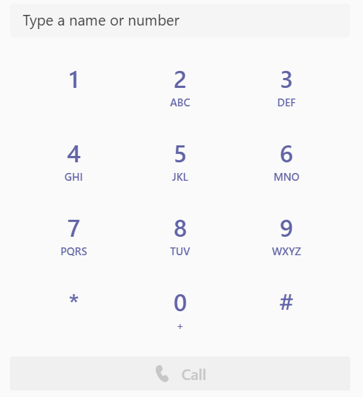
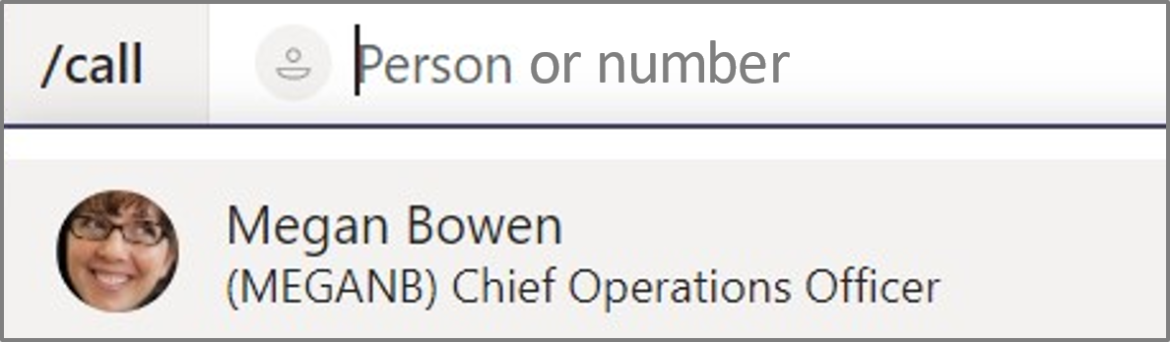
Initiate a Call
Video and audio icons allow you to initiate a call from Contacts or Contact Groups with one click.
Escalate any chat to a video or audio call.
The dial pad feature will accept a phone number that is copied and pasted to initiate a call. You may also click the numbers in the dial pad or type a number using the keyboard.
Use the /call command from the search field to make a call no matter where you’re working in Teams.
eits.uga.edu

Slide 13
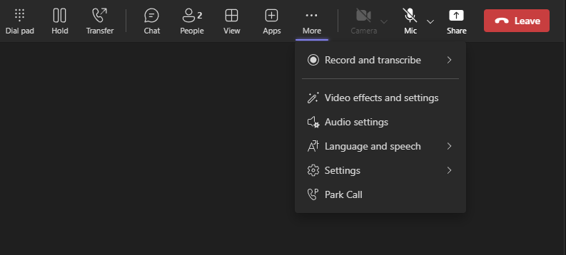
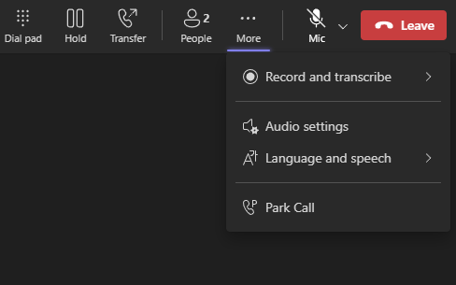
Call Controls
Call controls will appear slightly different if you are making an external call versus an internal call.
Internal (Teams to Teams)
External
eits.uga.edu

Slide 14

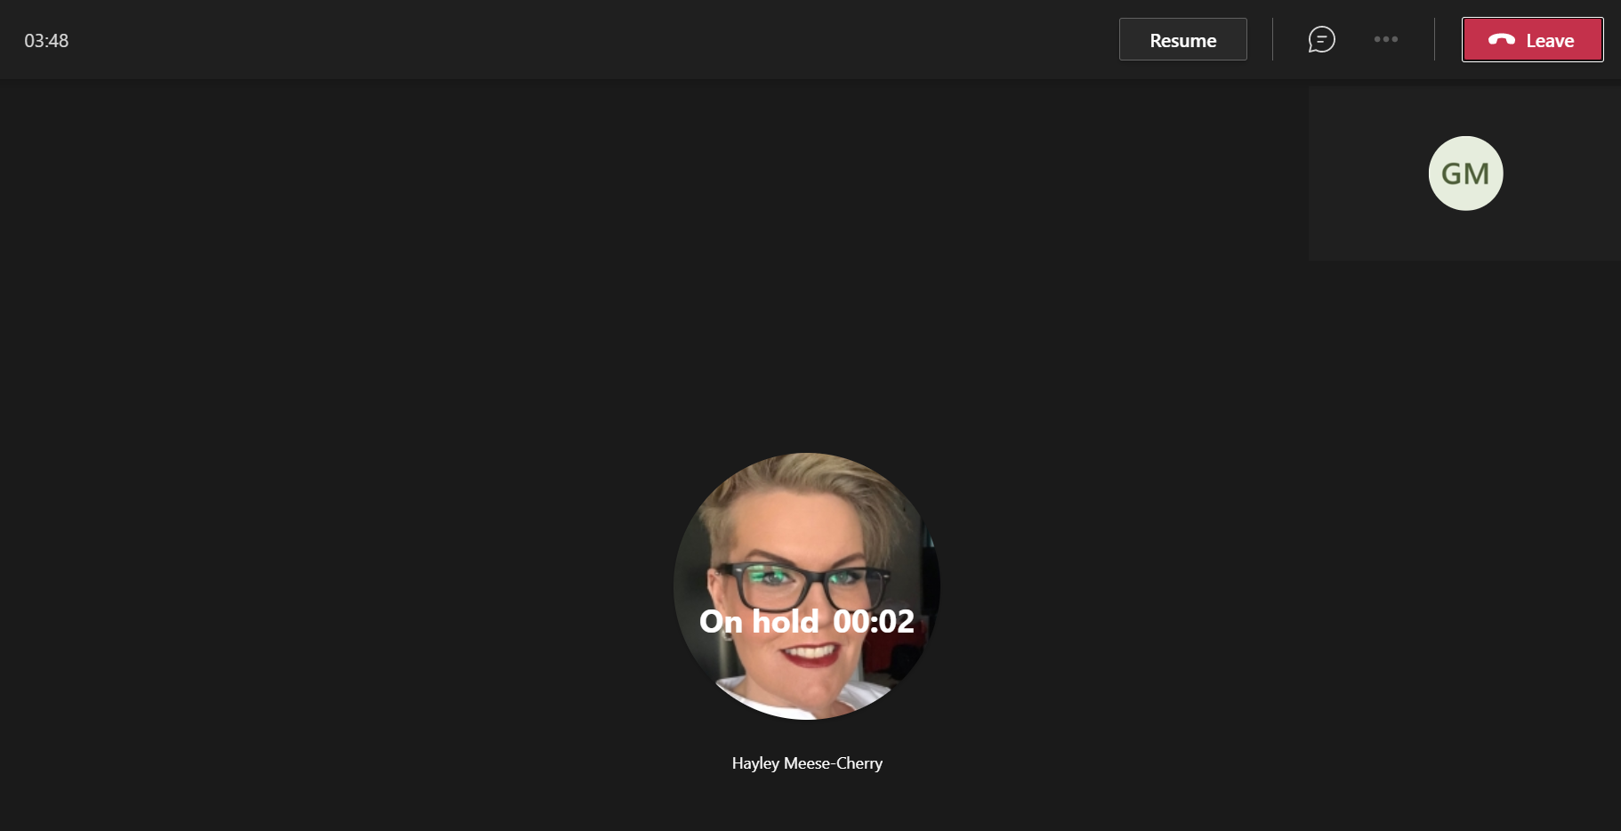
Hold
Place a call on Hold from the more options menu.
After placing a call on hold, you will either see a Resume in the control bar or on the main call screen.
eits.uga.edu

Slide 15
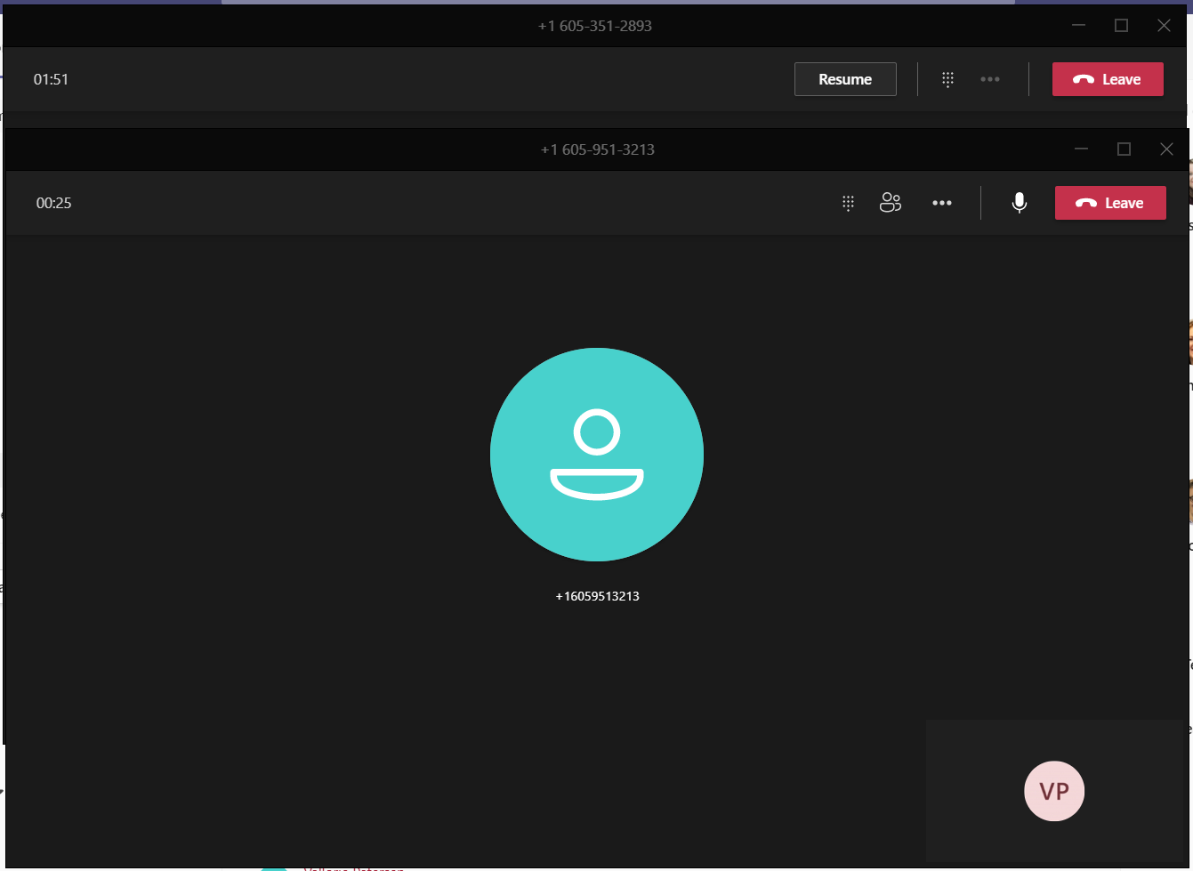
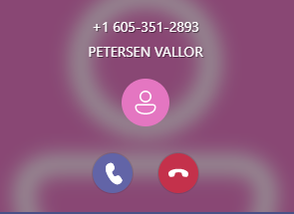
Multiple Calls Navigation
While only one call can be active at a time, you can toggle between multiple calls. If you accept an incoming call while on an active call, that active call will be automatically placed on hold, and the new call (if answered) will display in a separate call window. The call window(s) remain active until you select the Leave option, or the caller hangs up.
Original call window, on hold if second call answered
After placing a call on hold, you will see Resume in the control bar or on the main call screen. Click this to retrieve calls that have been hold.
Second incoming call window, active when answered.
Third incoming call
Declined Calls Note:
When a call is declined, the call will follow the call answering rules that have been established in settings. Additionally, the caller will not know their call has been declined. The caller will hear the standard number of rings before being redirected.
eits.uga.edu

Slide 16
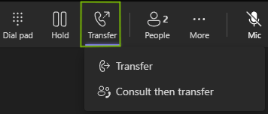
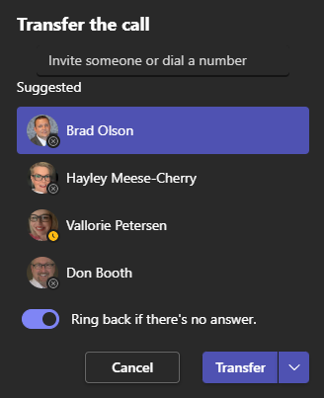
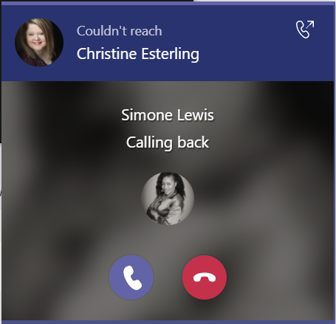
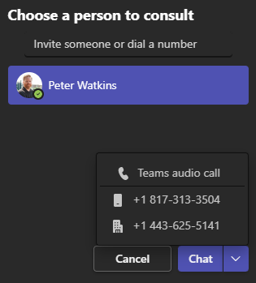
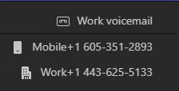
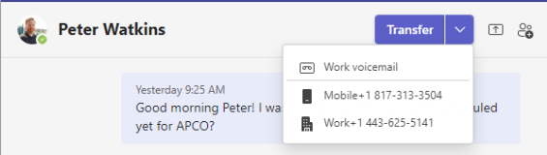
Transfer
You can choose between a blind and consultative transfer from the more options menu.
Ring back if there’s no answer is only available when transferring the call Teams-to-Teams.
eits.uga.edu

Slide 17
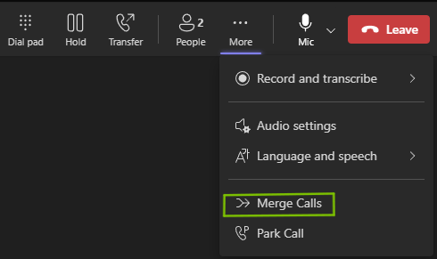
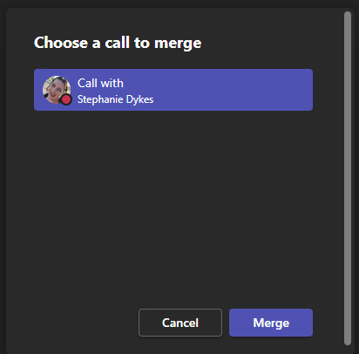
Call Merge
Whether you have received a new call while actively on a call, or if you have made a second outgoing call, the Call merge feature will allow you to merge these two calls into one.
From the active call, access the ellipsis and select Merge Calls.
A new window will appear allowing you to choose which call to merge. Select the other caller and click Merge.
eits.uga.edu

Slide 18
Call Settings

Slide 19
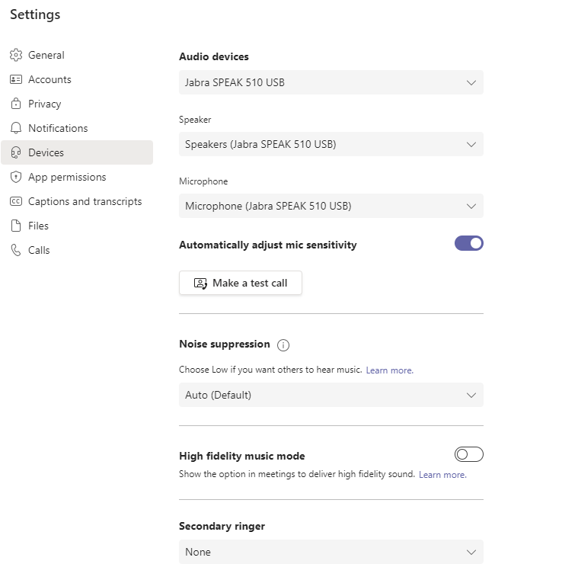
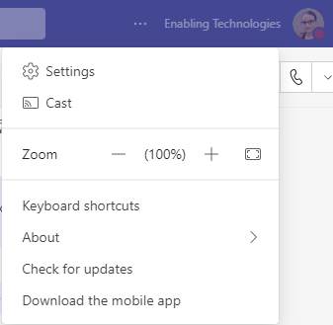
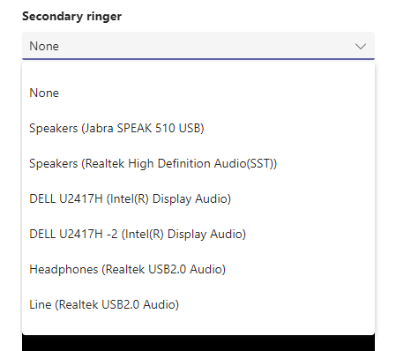
Create a Secondary Ringer
The Secondary Ringer feature will be helpful if you take your headset off and still need to hear an incoming call. This will enable your headset and your computer to ring when a call comes in.
Navigate to Settings by clicking the ellipsis in the top, right of your screen and select Settings.
Next tap Devices and then select the drop-down under Secondary Ringer
Under Secondary Ringer, click the drop-down arrow to choose where you would also like your ringtone to sound when receiving a call.
eits.uga.edu

Slide 20
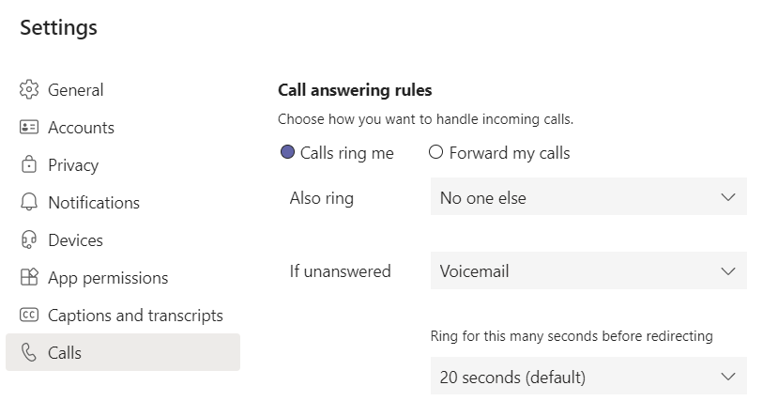
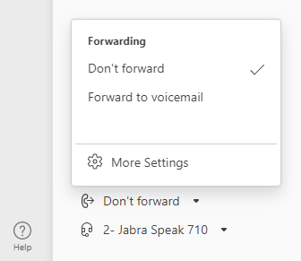
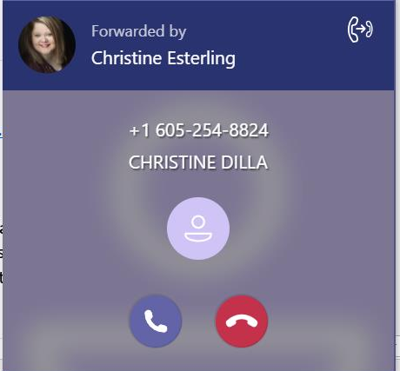
Call Answering Rules
Call answering rules can be set up to forward calls or also ring a peer or alternate phone number.
Adjust how long the phone rings before redirecting.
Quick access to call answering rules are now available by selecting the Forwarding drop-down menu in the bottom left corner of your Calls menu.
A forwarded call will have a banner at the top of the call notification indicating who is forwarding the call.
eits.uga.edu

Slide 21
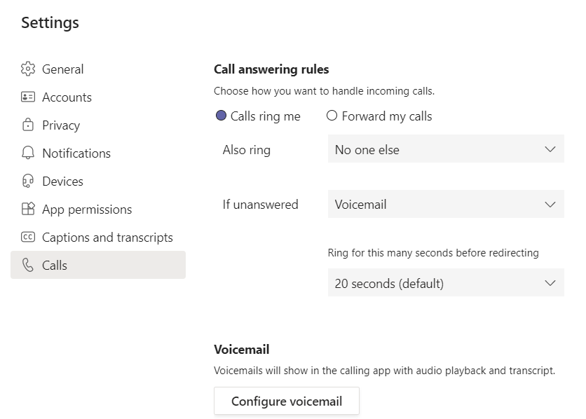
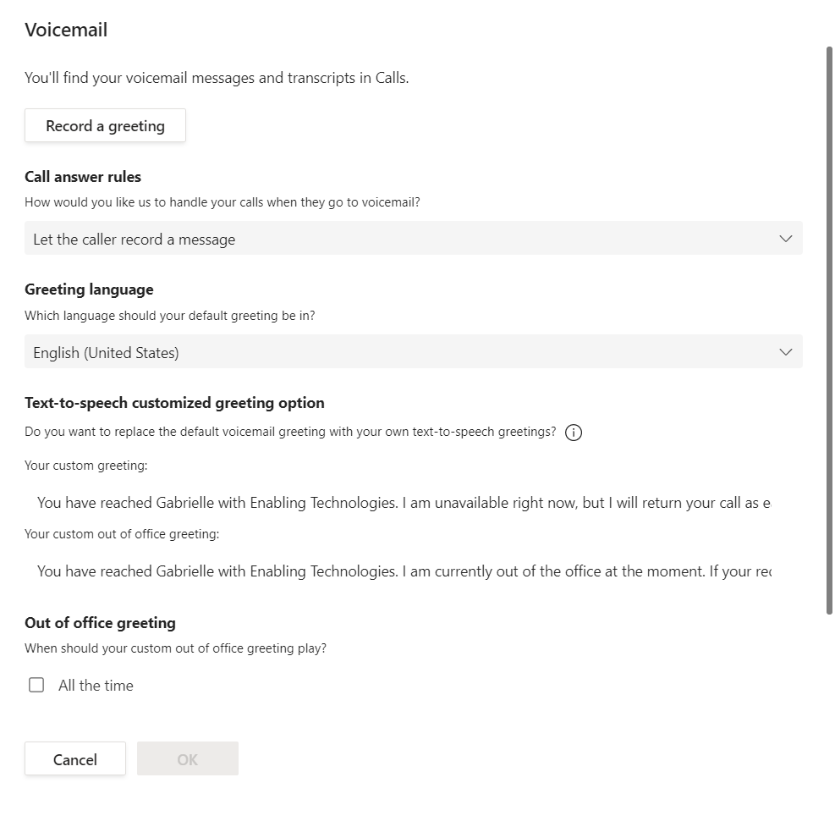
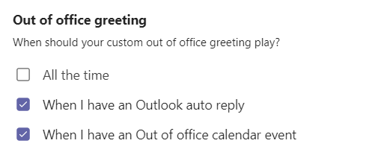
Voicemail Configuration
Click Configure voicemail to change your voicemail greeting and rules for handling calls that go to voicemail.
eits.uga.edu

Slide 22
Mobile App

Slide 23
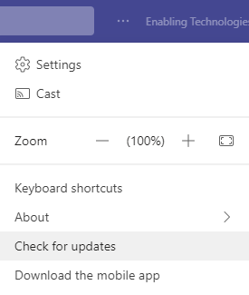
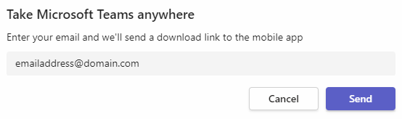
Download the Mobile App
From the Teams Desktop Application, select the more options button and click Download the mobile app.
Enter an email address accessible from your mobile device and Teams will send a link to download the mobile app.
Click the emailed link from your mobile device to launch the mobile app store .
Use your personal app store account to download the Teams app.
Once downloaded, use your work credentials to sign in.
eits.uga.edu

Slide 24
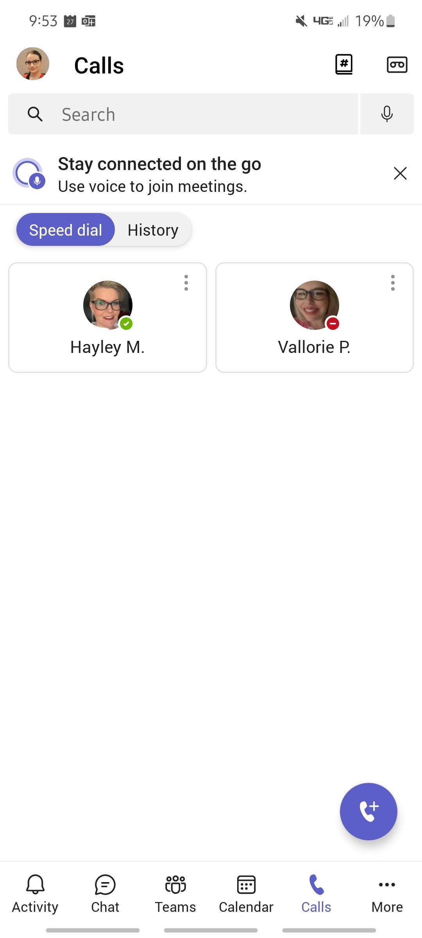
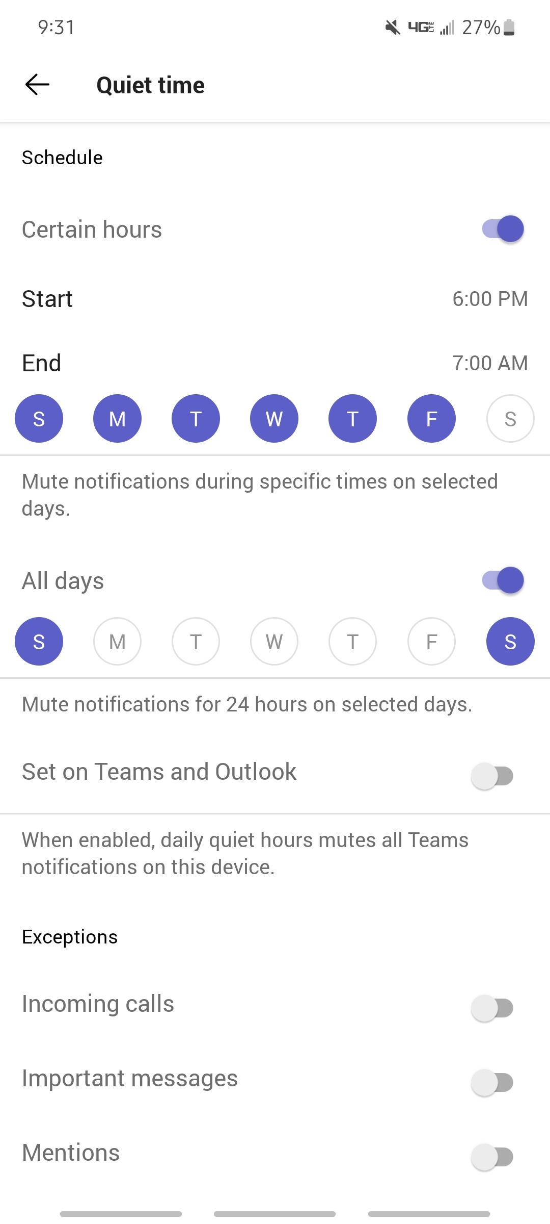
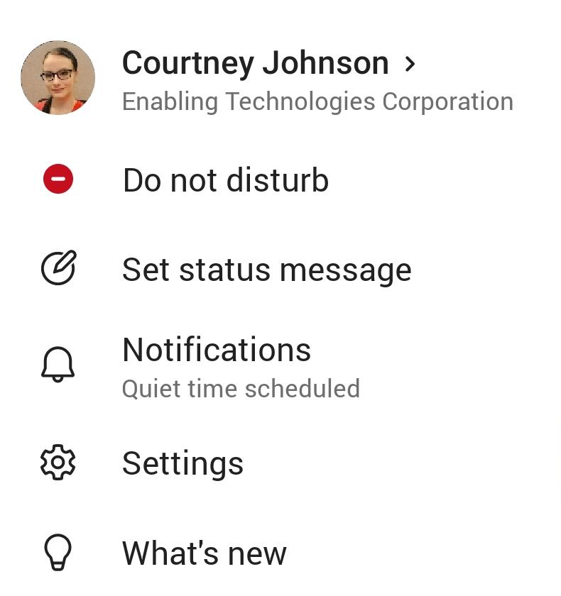
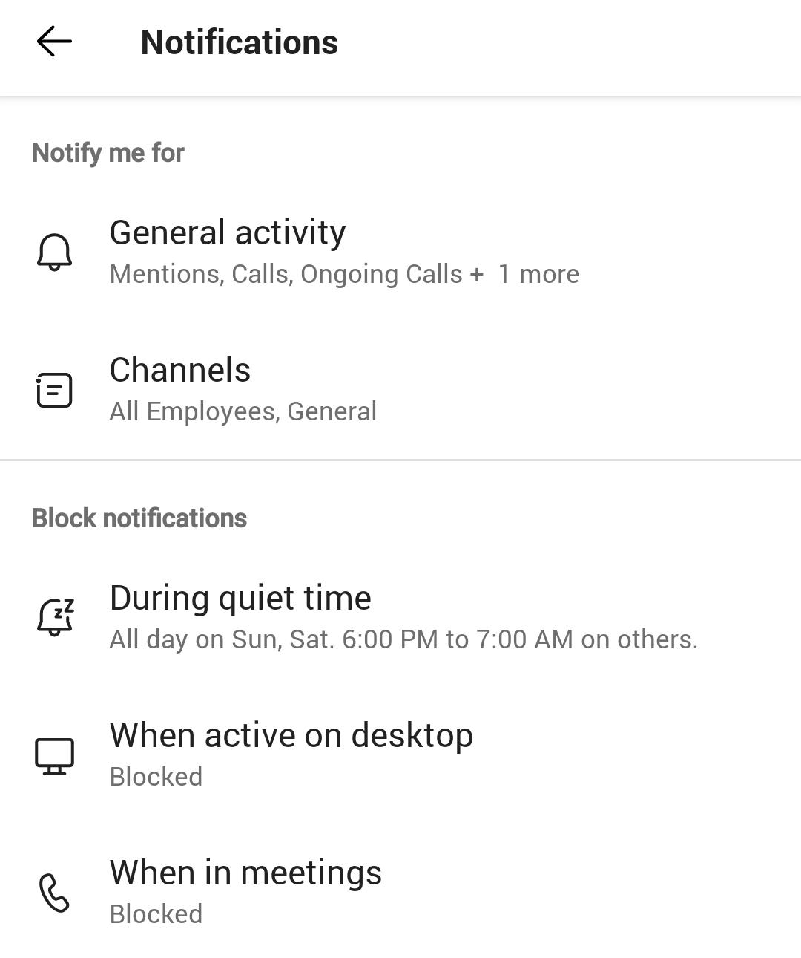
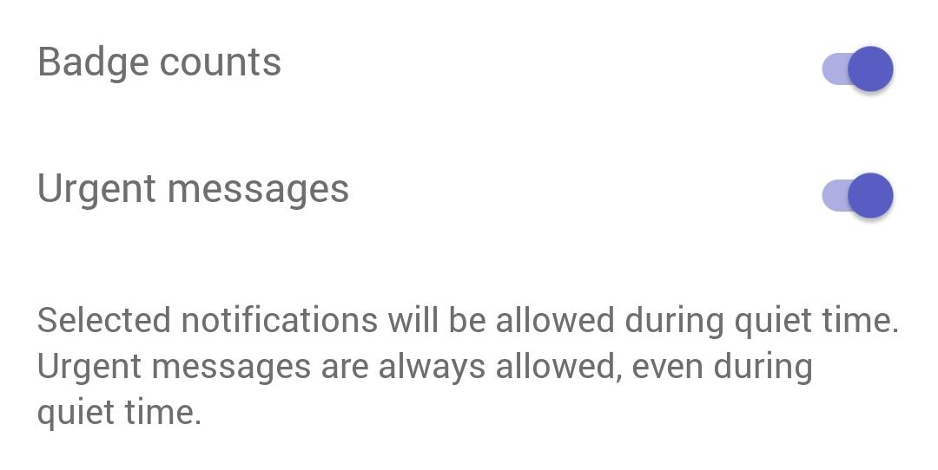
Schedule Quiet Time
Click on your initials or profile picture icon in the upper left corner
Select Notifications
Click During quiet time
Click on the switch next to Certain hours
Set your Start and End time,
  Notifications from the Teams mobile app will be disabled during these hours every day (calls will still come through)
Select the Quiet days for which to block notifications for the whole day
If you are an Android User, under Exceptions, choose which notifications you would like to allow through during your set quiet time.
Note: If you have multiple mobile devices with Microsoft Teams app installed there is no synchronization of quiet hours settings between those clients.
eits.uga.edu

Slide 25
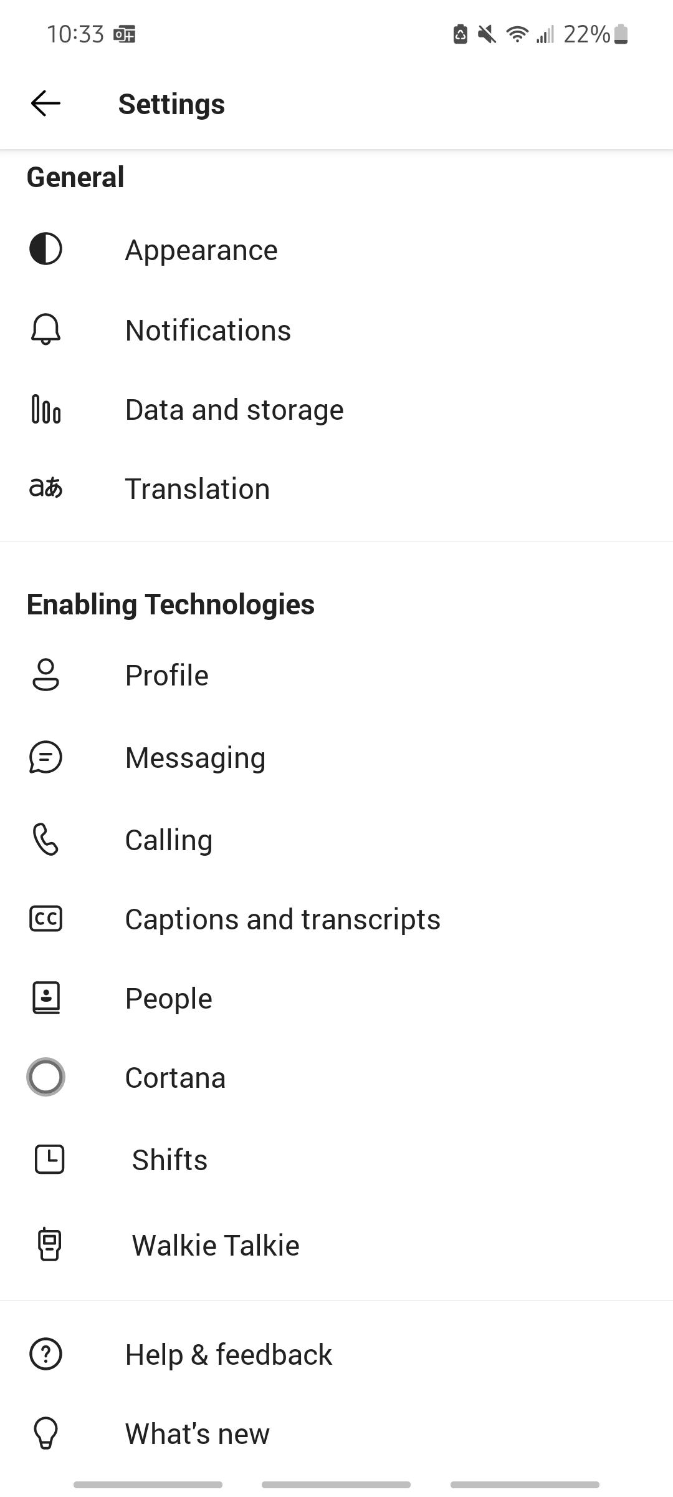
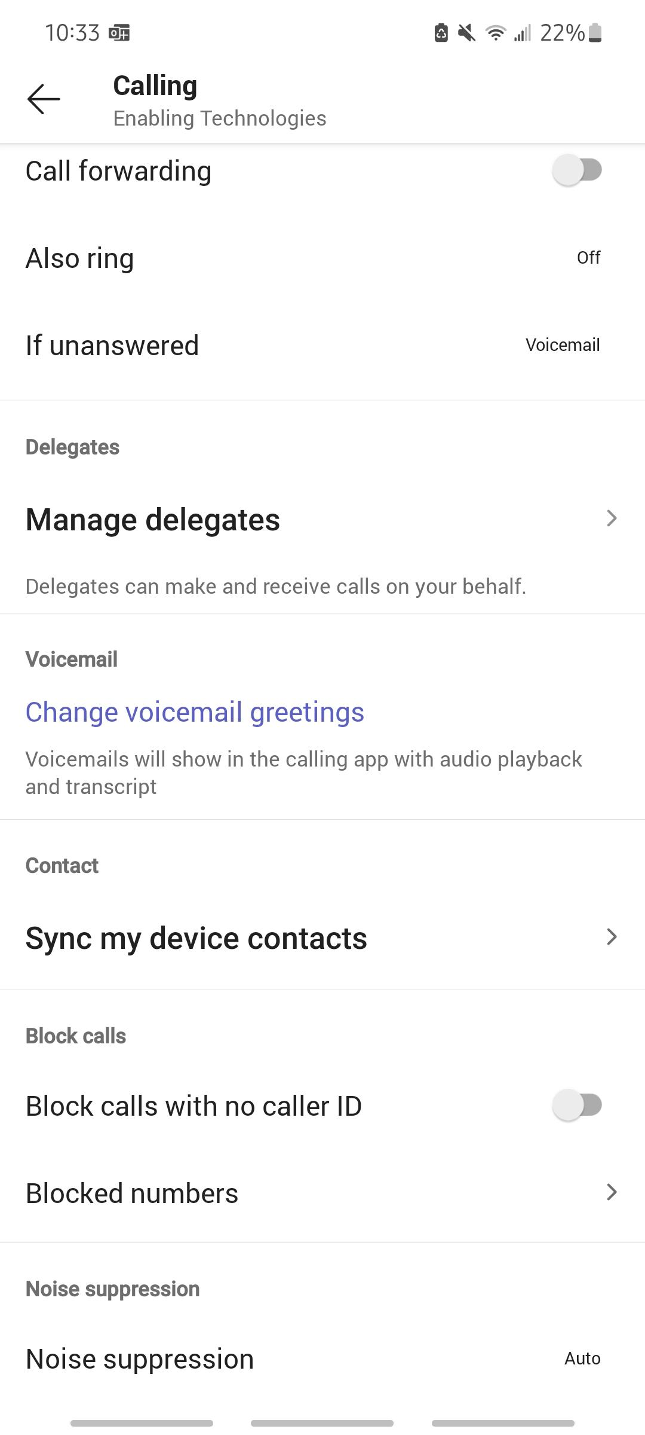
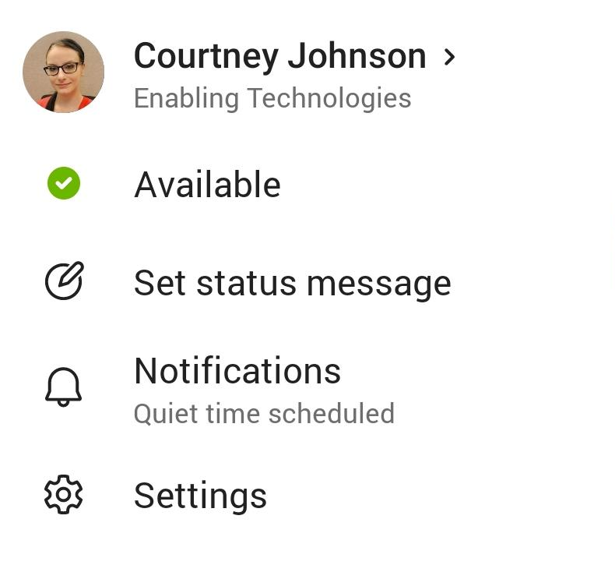
Mobile App Call Settings
Call settings can also be managed from the Teams mobile application.
Click Settings and Calling to find settings that include:
Call forwarding
Voicemail configuration
Blocked numbers
Call queues
eits.uga.edu

Slide 26






Teams Calls - Mobile
Calls in the mobile app is a consistent experience from the desktop application. Review call history, voicemail, contacts (including device contacts). Initiate calls with a dial pad (if enabled) or dial-by-name.
eits.uga.edu

Slide 27


Device Transfer
Meetings can also be transferred to your mobile application when you need to be on the go during a meeting.
Access the Calendar in the Teams mobile application and click Join for the active meeting you are in.
You will be prompted with options to join the meeting, select to Transfer to this device.
eits.uga.edu

